Slide 1
Maths

Slide 2
New Maths GCSE from 2017
Exam board is Edexcel
100% examined (no coursework)
THREE written exams
Paper 1 Non calculator (80 marks) 1 ½ hours
Paper 2 Calculator (80 marks) 1 ½ hours
Paper 3 Calculator (80 marks) 1 ½ hours
All papers can contain content from the whole curriculum
Graded from 1 to 9

Slide 3
Grade boundaries
Change every year based on cohort but we need to aim for the following
Foundation
50 marks per paper (150 total) for a 4
65 marks per paper (185 total for a 5)
Higher
30 marks per paper (90 total) for a 5
40 marks per paper (120 total) for a 6
50 marks per paper (150 total) for a 7
60 marks per paper (180 total) for an 8
70 marks per paper (210) total for a 9

Slide 4
New Maths GCSE from 2017
Much greater focus on problem-solving.
Requirement to provide clear mathematical arguments.
A lot of new added content at both Higher and Foundation level.
No formulae provided. (Students expected to remember them!)
Formulae was provided for the 2023 papers

Slide 5
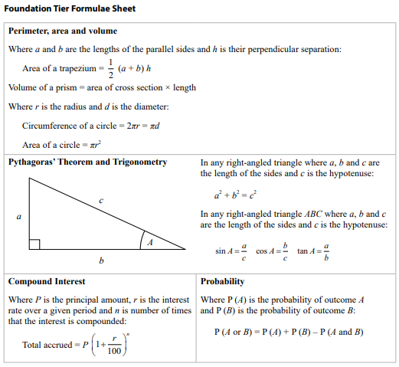

Slide 6
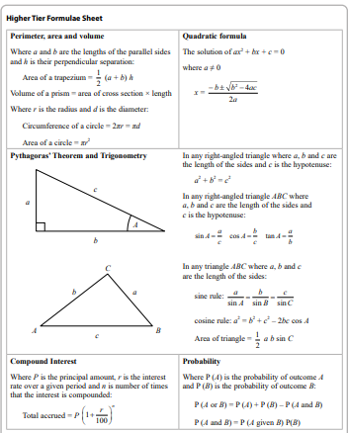

Slide 7
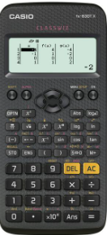
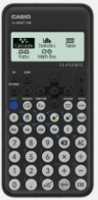
The tools to do the job!
Fx-83GT plus
Fx-83GTx
Fx-83GT classwiz

Slide 9
The best, most useful resource…
www.drfrostmaths.com
School email
All passwords have been reset to password

