Slide 1
Y11 Science exams and revision support
 | Combined foundation | Combined higher | Single/triple science
Exam board | AQA | AQA | AQA
Exam papers | 6 | 6 | 6
Exam lengths | 1 hour 15 mins each | 1 hour 15 mins each | 1 hour 45 mins each
Total marks available | 420 | 420 | 200 per subject

Slide 2
Y11 grade boundaries last year
 | Combined foundation | Combined higher | Single/triple science (higher)
Grade 4 | 229 (55%) | 99 (24%) | 48 (24%)
Grade 5 | 269 (64%) | 138 (33%) | 70 (35%)
Grade 7 |  | 220 (52%) | 114 (57%)
Grade 9 |  | 291 (69%) | 150 (75%)
Maximum | 420 | 420 | 200 (each)

Slide 3
Y11 revision support provided
Multichoice quiz
All core knowledge
Revision question mats
Questions without multi choice
Exam practice
Can they apply their memory?
Correct answers shown immediately after completion
Unlimited attempts
Mobile accessible
Self marked by the student
Tests memory of core knowledge

Slide 4
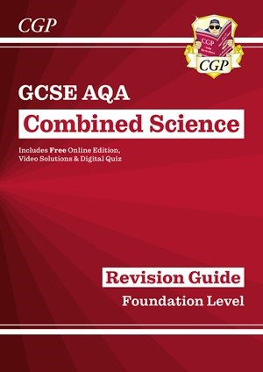
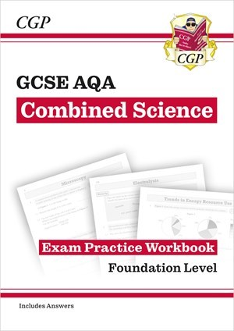
Y11 revision guides recommended
 | Revision guide | Revision workbook
AQA trilogy foundation | https://www.cgpbooks.co.uk/secondary-books/gcse/science/combined-science/safr46-gcse-combined-science-aqa-revision | https://www.cgpbooks.co.uk/secondary-books/gcse/science/combined-science/safq42b-gcse-combined-science-aqa-exam?c=39012749
AQA trilogy Higher | https://www.cgpbooks.co.uk/secondary-books/gcse/science/combined-science/sahr46-gcse-combined-science-aqa-revision | https://www.cgpbooks.co.uk/secondary-books/gcse/science/combined-science/sahq42b-gcse-combined-science-aqa-exam?c=26864432

Slide 5
Y11 revision guides recommended
 | Revision guide | Revision workbook
Biology (single science) | https://www.cgpbooks.co.uk/secondary-books/gcse/science/biology/bar46-gcse-biology-aqa-revision-guide-higher | https://www.cgpbooks.co.uk/secondary-books/gcse/science/biology/baq42b-gcse-biology-aqa-exam-practice?c=17403815
Chemistry (single science) | https://www.cgpbooks.co.uk/secondary-books/gcse/science/chemistry/car46-gcse-chemistry-aqa-revision-guide?c=21412324 | https://www.cgpbooks.co.uk/secondary-books/gcse/science/chemistry/caq42b-gcse-chemistry-aqa-exam-practice?c=37369838
Physics (single science) | https://www.cgpbooks.co.uk/secondary-books/gcse/science/physics/par48-gcse-physics-aqa-revision-guide-higher?c=8423343 | https://www.cgpbooks.co.uk/secondary-books/gcse/science/physics/paq42b-gcse-physics-aqa-exam-practice?c=66866052

Slide 6
Y11 revision quiz links
Unit | Biology | Chemistry | Physics
1 | https://forms.gle/hHYkwL8gMC5zYcJ69 | https://forms.gle/ZFcyebeTgQyckLUi7 | https://forms.gle/fPoiuRdgCfSjG6n49
2 | https://forms.gle/1Th7wz61se3A9FDX9 | https://forms.gle/RUxRy2d6yDryuudj9 | https://forms.gle/PpdiWRMcgrPxf4ct9
3 | https://forms.gle/iGcQY8By1Kv5Uo388 | https://forms.gle/7HDW7eYLMZNjTK2G8 | https://forms.gle/ogHc1ebNpMojWLA3A
4 | https://forms.gle/irV57xsurvKZGbzaA | https://forms.gle/rd71UxcLuyeVD2pRA | https://forms.gle/fcjjPxmajPNeKEcUA
5 | https://forms.gle/dVSynbsg2bDjYZX56 | https://forms.gle/AT6HAi5N3feuMLscA | https://forms.gle/NZqakmN8ig3H4A5k6
6 | https://forms.gle/35KFPn8wzKVr3ET8A | https://forms.gle/JZAtuKjsGQ4kjY4i6 | https://forms.gle/HurRVKeAthTUdMFZ6
7 | https://forms.gle/DjLTQz9gMkavombn8 | https://forms.gle/198sneiuaufDMMs8A | https://forms.gle/qmhWHAN4LYqFzcH9A
8 |  | https://forms.gle/D6v9YbW3u35CA2uP8 | https://forms.gle/3MquxNAg4SmT2ohCA (triple)
9 |  | https://forms.gle/wYdTZ7qiY6MKYt3y5
10 |  | https://forms.gle/QLHuQ7674xpY2ZHH8

