Slide 1
English Language & English Literature
Director of Faculty – Mrs S Gardner
Assistant Director of KS4 – Mrs D Ryles

Slide 2
AQA English Language
2 Papers – worth 80 marks (50% each of the English Language GCSE)
Language Paper 1: Explorations in creative reading and writing (1 hour 45 minutes)
Language Paper 2: Writers’ viewpoints and perspectives
(1 hour 45 minutes)
Spoken Language – Pass, Merit, Distinction

Slide 3
AQA English Literature
2 papers – 160 marks in total
Literature Paper 1: Macbeth and A Christmas Carol (64 marks in total)
1 hour 45 minutes
Literature Paper 2: Modern texts and poetry 2 hours 15 minutes
Section A: An Inspector Calls (34 marks)
Section B Power and Conflict Poetry (30 marks)
Section C Unseen poetry (32 marks)
Closed book exams!

Slide 4
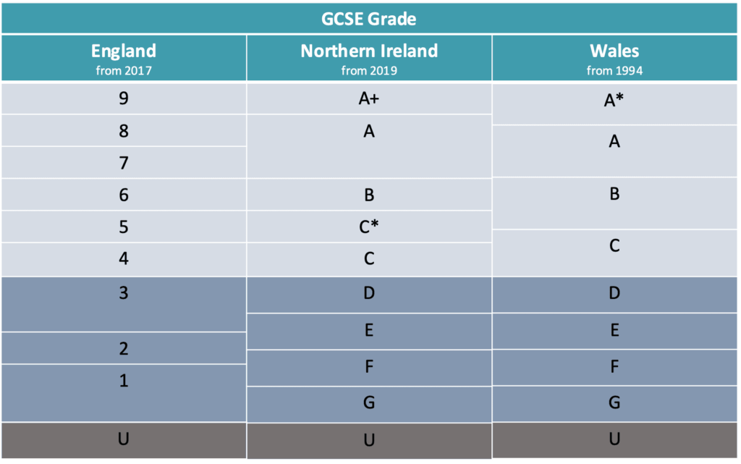

Slide 5
Language Grade Boundaries
9 – 64
8 – 59
7 – 54
6 – 49
5 – 43
4 – 38
3 – 28
2 – 18
1 – 8

Slide 6
An Inspector Calls, Power and Conflict Poetry, Unseen Poetry
Macbeth & A Christmas Carol

Slide 8
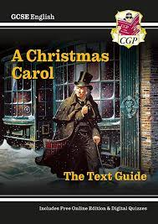
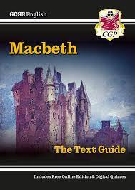
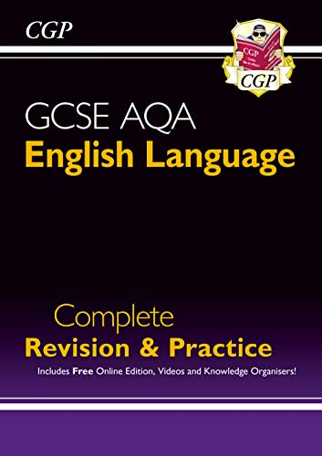
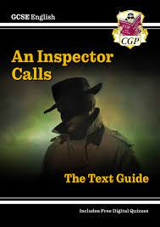
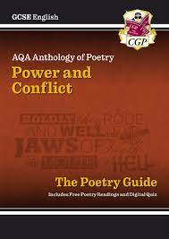
CGP £2.85 Parent Pay

Slide 9
The Literature Core Concepts (and our Literary Bibles)
4 core concepts per Lit text – students need to learn these!
Students should utilise these core concepts to form topic sentences / thesis statements which begin their paragraphs in the main body of their essays
It shows students’ understanding of the writers’ intentions and avoids bolt on, irrelevant contextual information

Slide 10
Killer Quotations
10 per Literature text (Macbeth, A Christmas Carol, An Inspector Calls)
Green – all students should remember
Yellow – additional quotes to recall if you can!
Questions to ask:
Complete the quote
Who said it?
When did they say it?
Why do they say it?
What theme(s) does it link to?
What writers’ methods (language techniques / structural devices) are being used?
How does it link to the social, historical context?

Slide 11
Practice Makes Perfect!
https://revisionworld.com/a2-level-level-revision/english-language-gcse-level/english-language-gcse-past-papers/aqa-gcse-english-language-past-papers
https://revisionworld.com/a2-level-level-revision/english-literature-gcse-level/english-literature-gcse-past-papers/aqa-gcse-english-literature-past-papers

Slide 12
YouTubers
Mr Bruff
Stacey Reay
5-10 minute videos
Make bullet point notes

Slide 13
Aim Higher
Wider reading – other texts linked to the Literature texts / reading and discussing topical news articles
https://www.douglaswise.co.uk/ks4-teaching-resources/
Deconstructing WAGOLLs (What A Good One Looks Like – exemplar responses)
https://susansenglish.wordpress.com
https://mrhansonsenglish.wordpress.com
https://madameanglaise.wordpress.com

