Slide 1
GCSE Geography

Slide 2
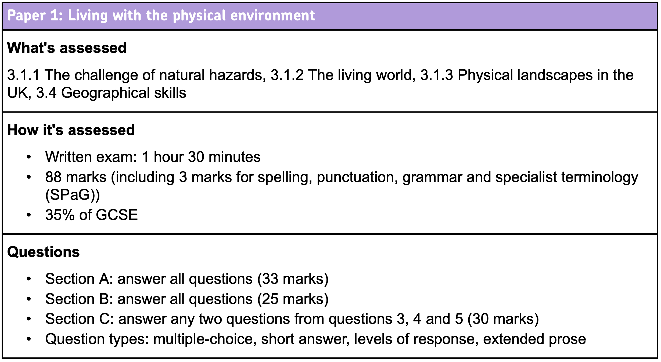
Understanding the Examination

Slide 3
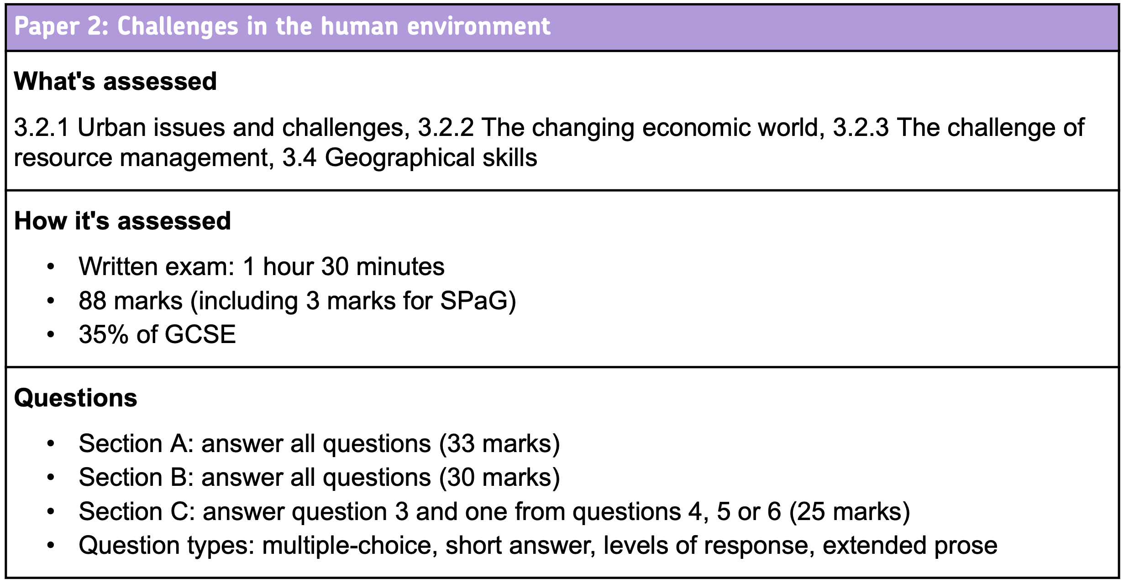
Understanding the Examination

Slide 4
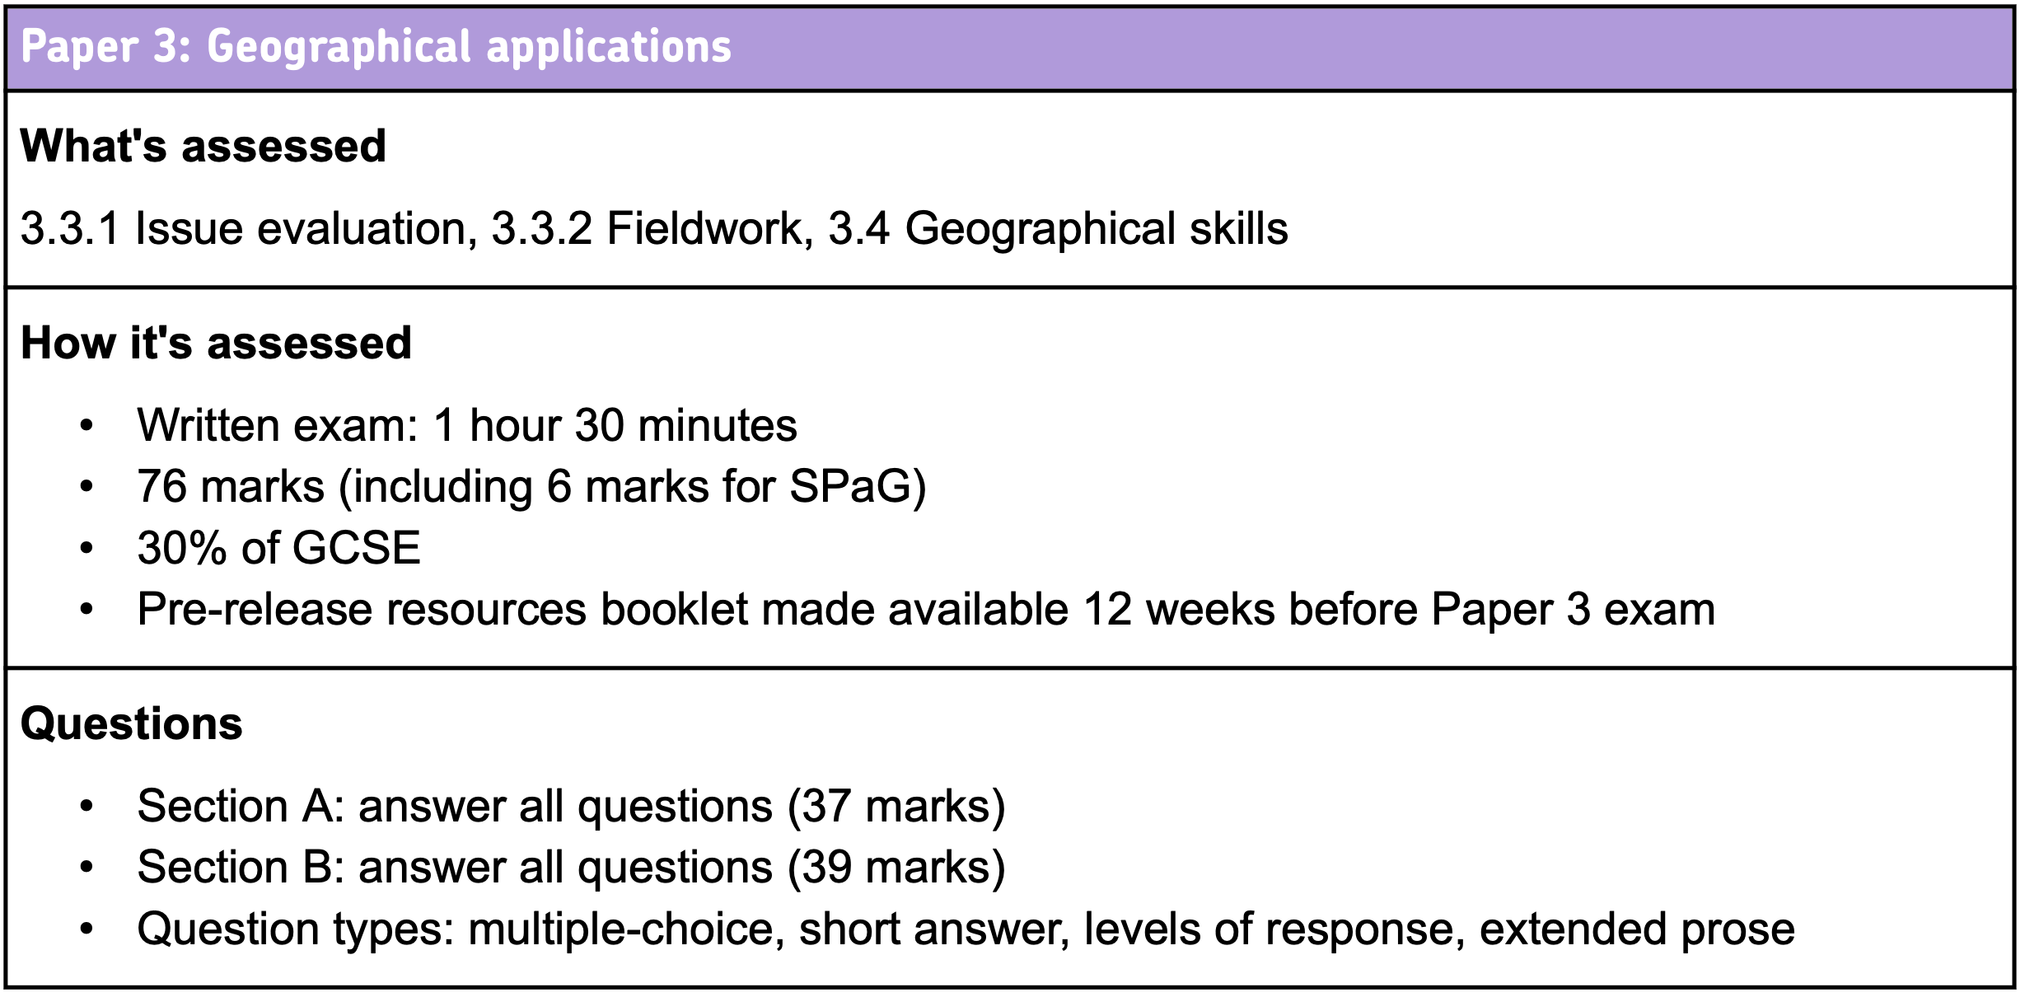
Understanding the Examination

Slide 5
Useful Websites
AQA – GCSE Geography
BBC Bitesize

